Slide 1


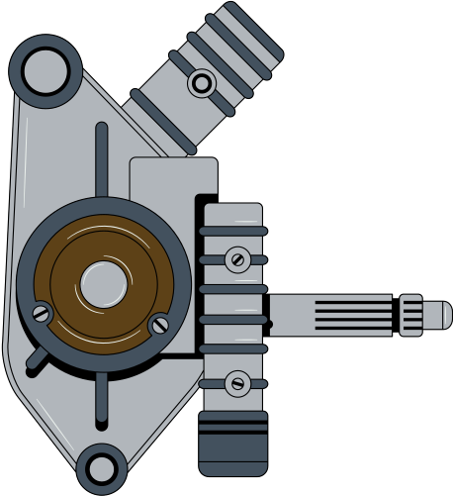
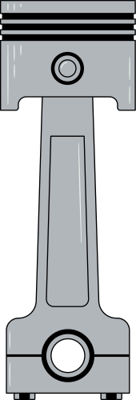




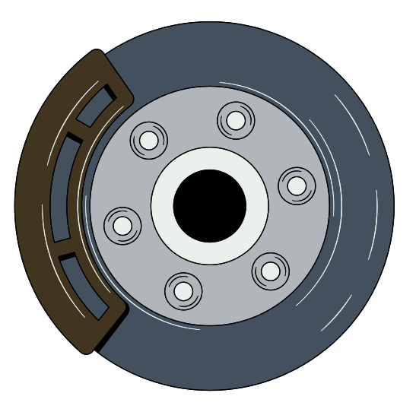


E-Commerce website
for automotive parts

Slide 2
Member of Group
Nguyễn Hải Quân - ITITWE21104
Nguyễn Trung Tín - ITITDK21064
Nguyễn Vũ Minh Thư - ITITWE21112

Slide 3

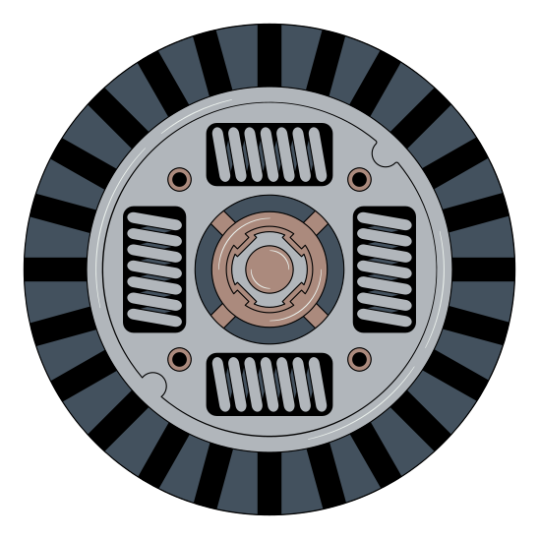







Aim of the project
Autoparts Hub is an online marketplace for automotive parts, featuring:
Purpose:
To simplify the process of buying and selling auto parts.
Scope:
A reliable, user-friendly platform with global accessibility.
Core Values:
Balances affordability and product quality.
Ensures transparency and trustworthiness in transactions.
Solves common consumer issues:
Reduces the risk of scams in online transactions.
Helps avoid poor-quality parts.
How it works:
Connects buyers and sellers through an intuitive system.

Slide 4



Technique & Tools
Front-End: Node.js with Embedded JavaScript (EJS)
Back-End: Node.js for server-side logic
Database: MySQL for data storage and management
Architecture: MVC (Model-View-Controller) pattern
Task Management: Google Sheets to track progress
Documentation & Data Storage: JSON format for raw data

Slide 5
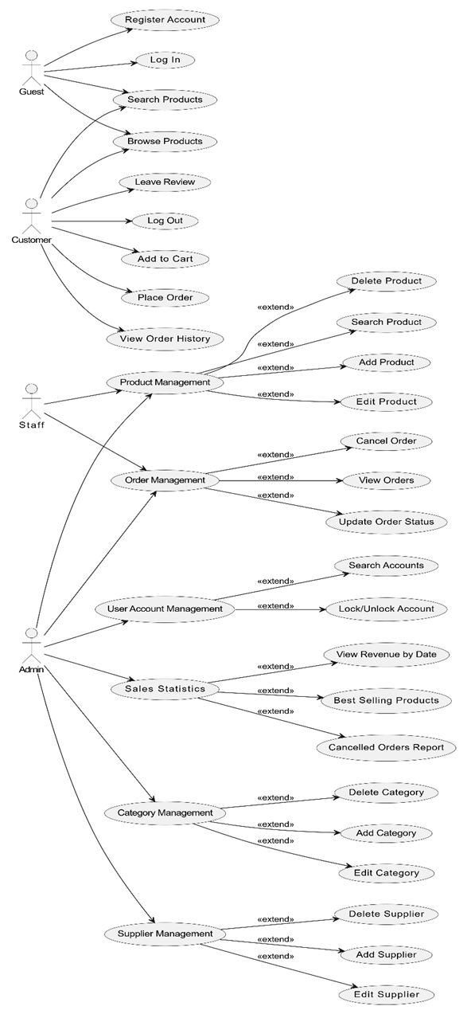
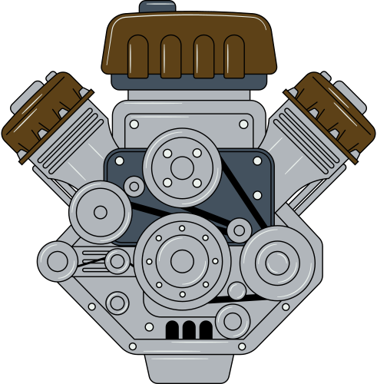
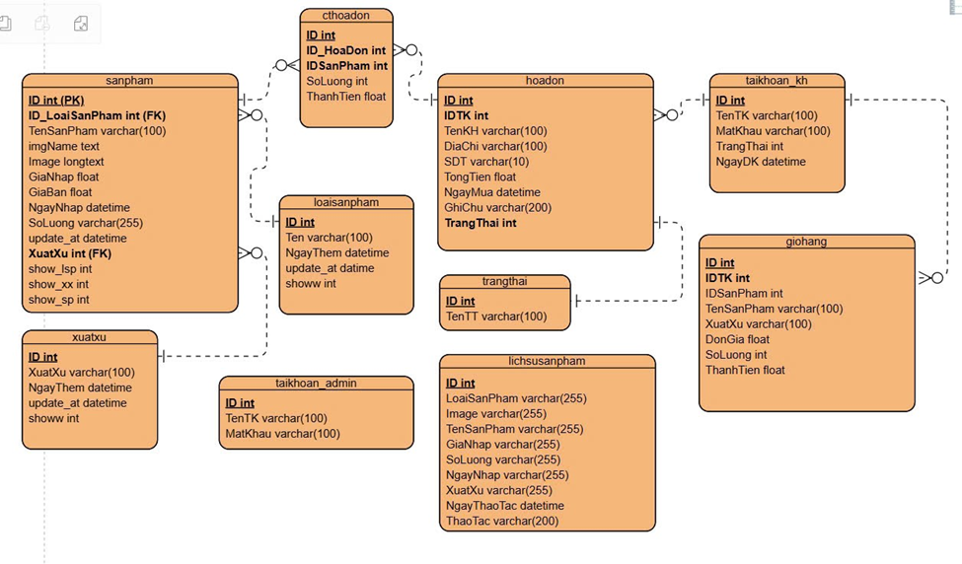
Use Case and ERD
Diagram

Slide 6

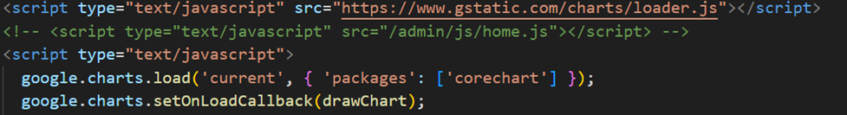

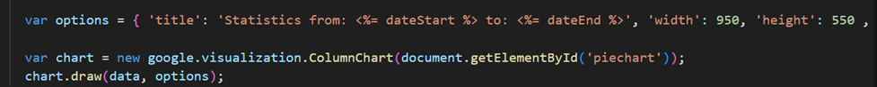
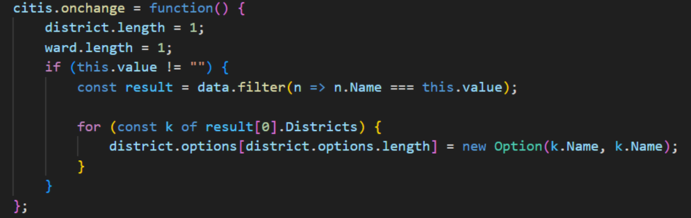
Frontend
Google Chart for admin
Google Column Chart in Statistical for admin
Customer Cart Page

Slide 7

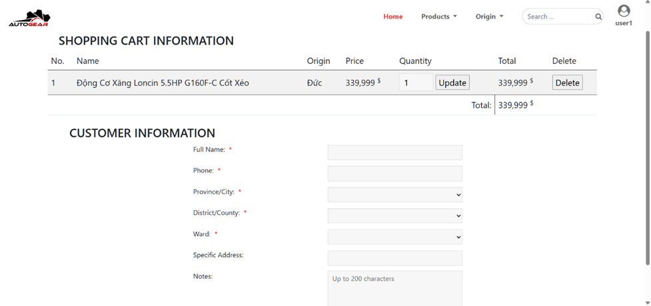
Frontend

Slide 8
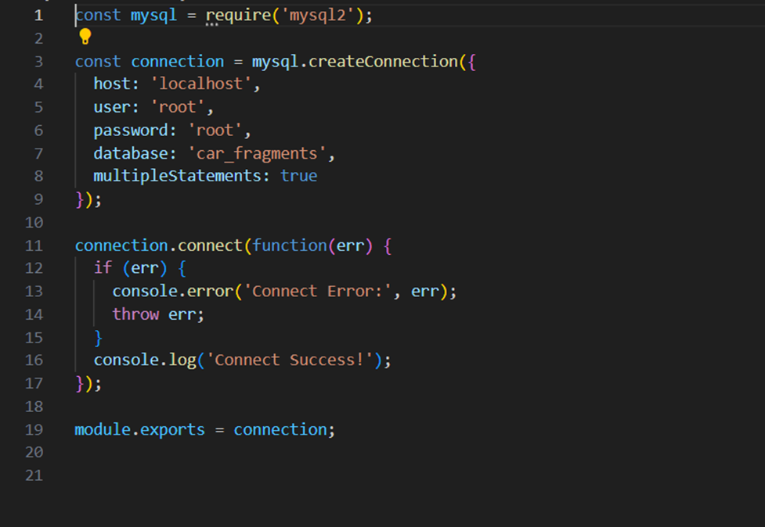
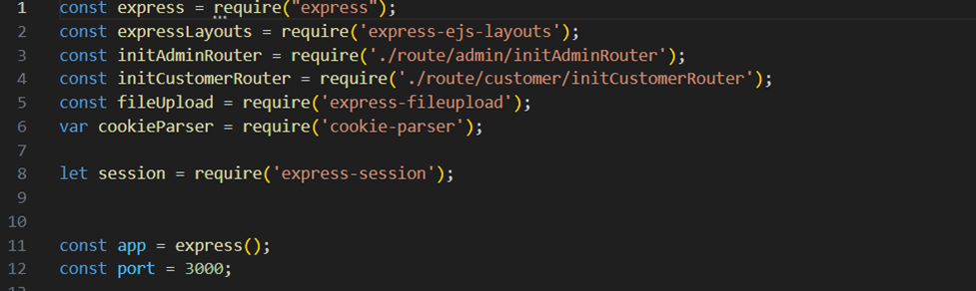
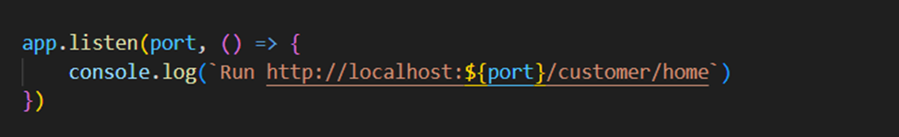
Backend
Database Connection Setup
Express Server Initialization
The entry point of the backend application, initializing Express and configuring middleware.

Slide 9
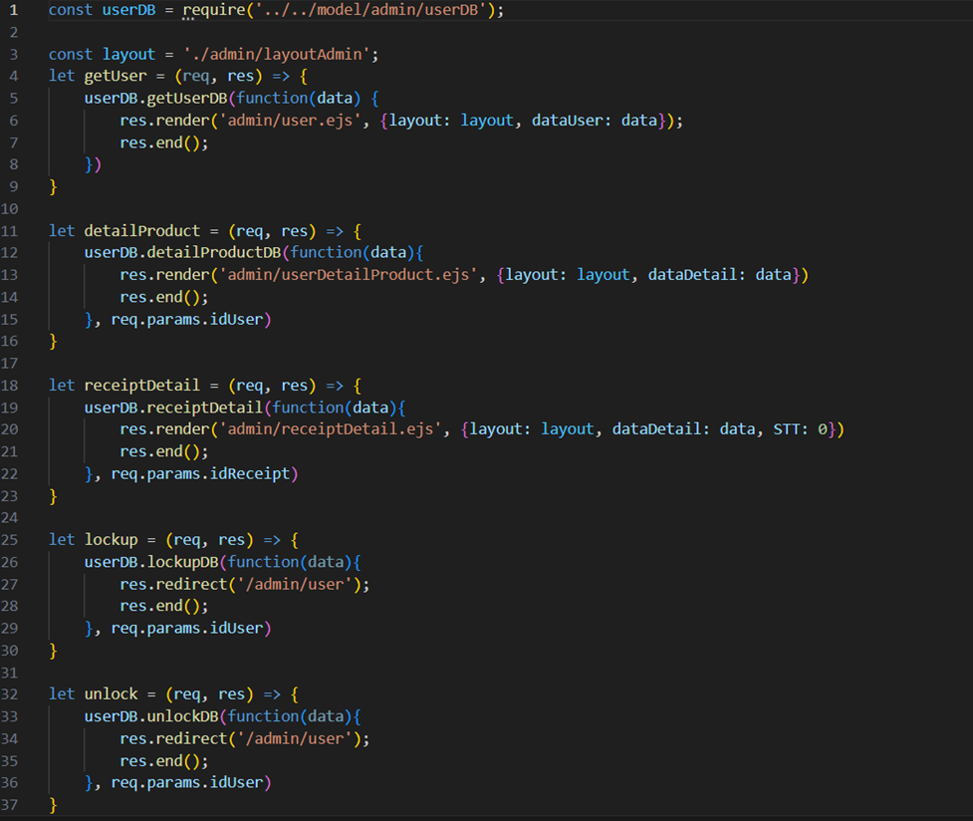
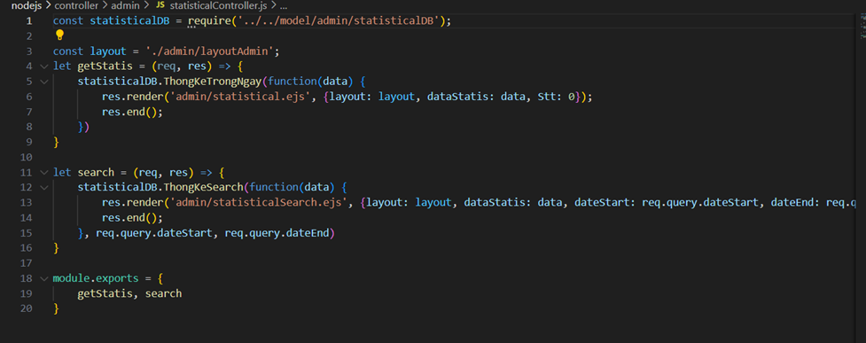
Backend
User Management Controller
Statistical Report Controller

Slide 10


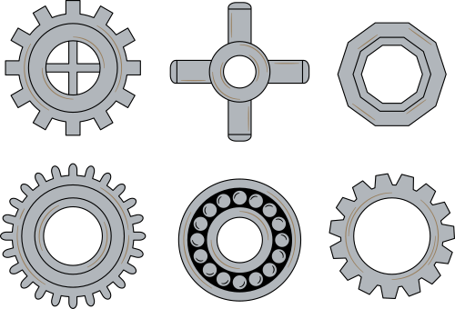



Conclusion
Full-stack & Cloud Integration
Gained practical experience in full-stack development and AWS-based cloud deployment.
Robust System Features
Built secure image storage, real-time vehicle comparison, and efficient inventory/data handling
Tech Stack Efficiency
Used Node.js with Ant Design for a responsive UI and Java Servlets for optimized backend logic.

Slide 11




